Slide 1
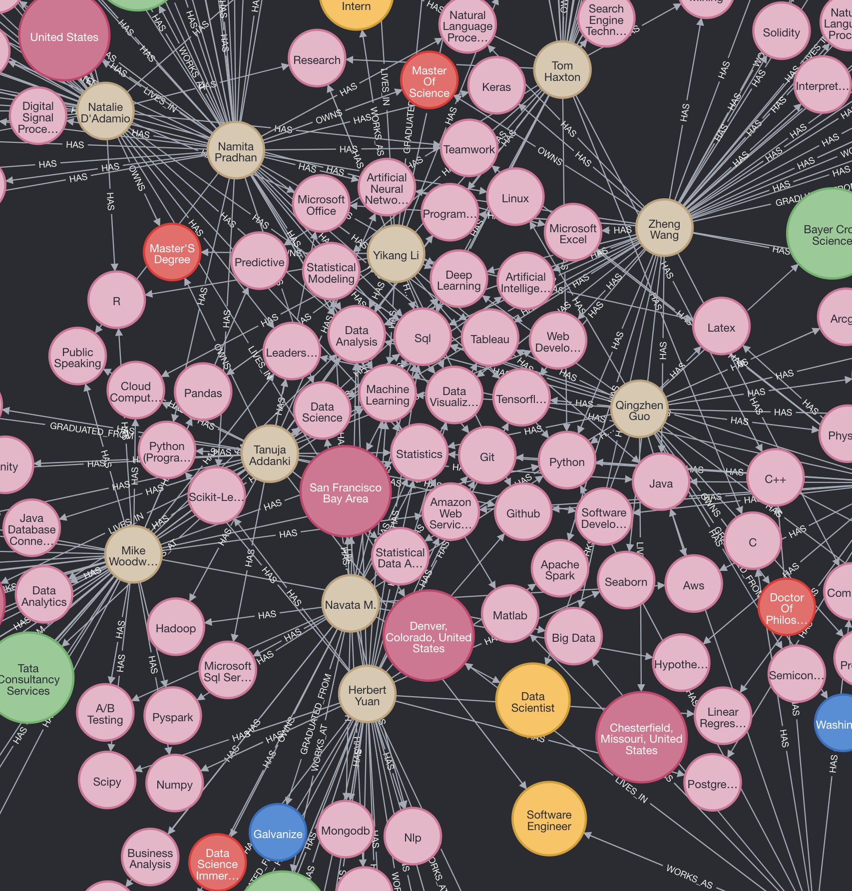
GRAPH DATABASE FOR LINKEDIN AND GITHUB PROFILE
Team Rocket
Steve, Yuan, Kayla

Slide 2
Agenda
Background
Workflow
Knowledge graph
Challenge and future work
Data Integration
Neo4j Demo

Slide 3
Background
For professionals who work in data science related fields, we would like to have automated process(knowledge graph) to review their career profiles and technical skillsets.
Can it help others who are interested in these topics to have a better understanding of these fields and help them to get into this career path or help human resources to look for better qualified candidates?

Slide 4

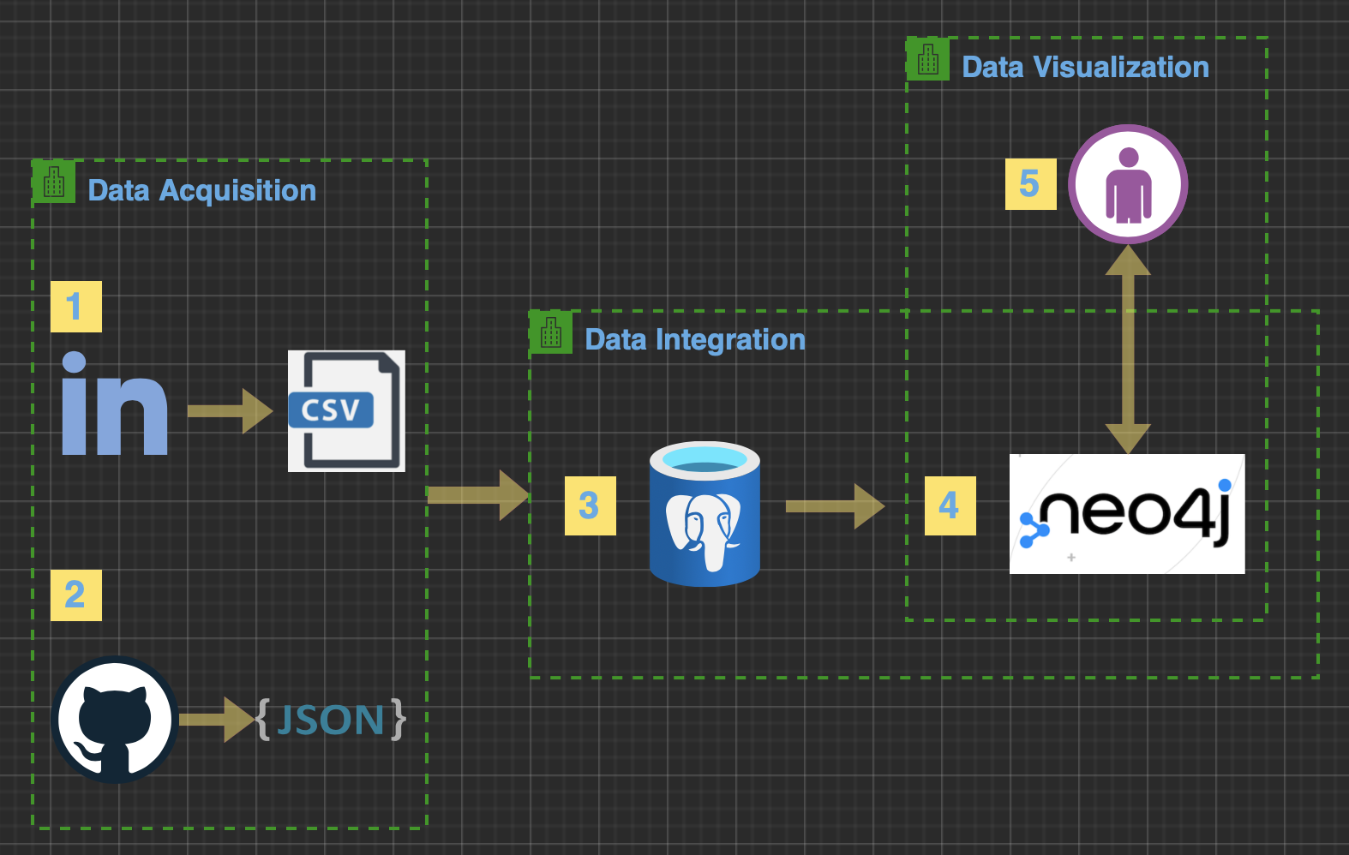
Workflow
Data Acquisition: web scraping
Scraped ~1000 linkedin profile urls with keywords "data scientist" "data engineer" and "data analyst" from google search
Scraped ~500 linkedin detailed profiles from linkedin.com
Scraped ~800 github repositories associated to scraped linkedin profiles from github.com
Output: structured csv and semi-structured JSON
Data Integration:
Processed structured and semi-structured data into relational entity relationships.
Turn entity relationship into knowledge graph with Neo4j.
Data Visualization:
Run queries with neo4j desktop

Slide 5
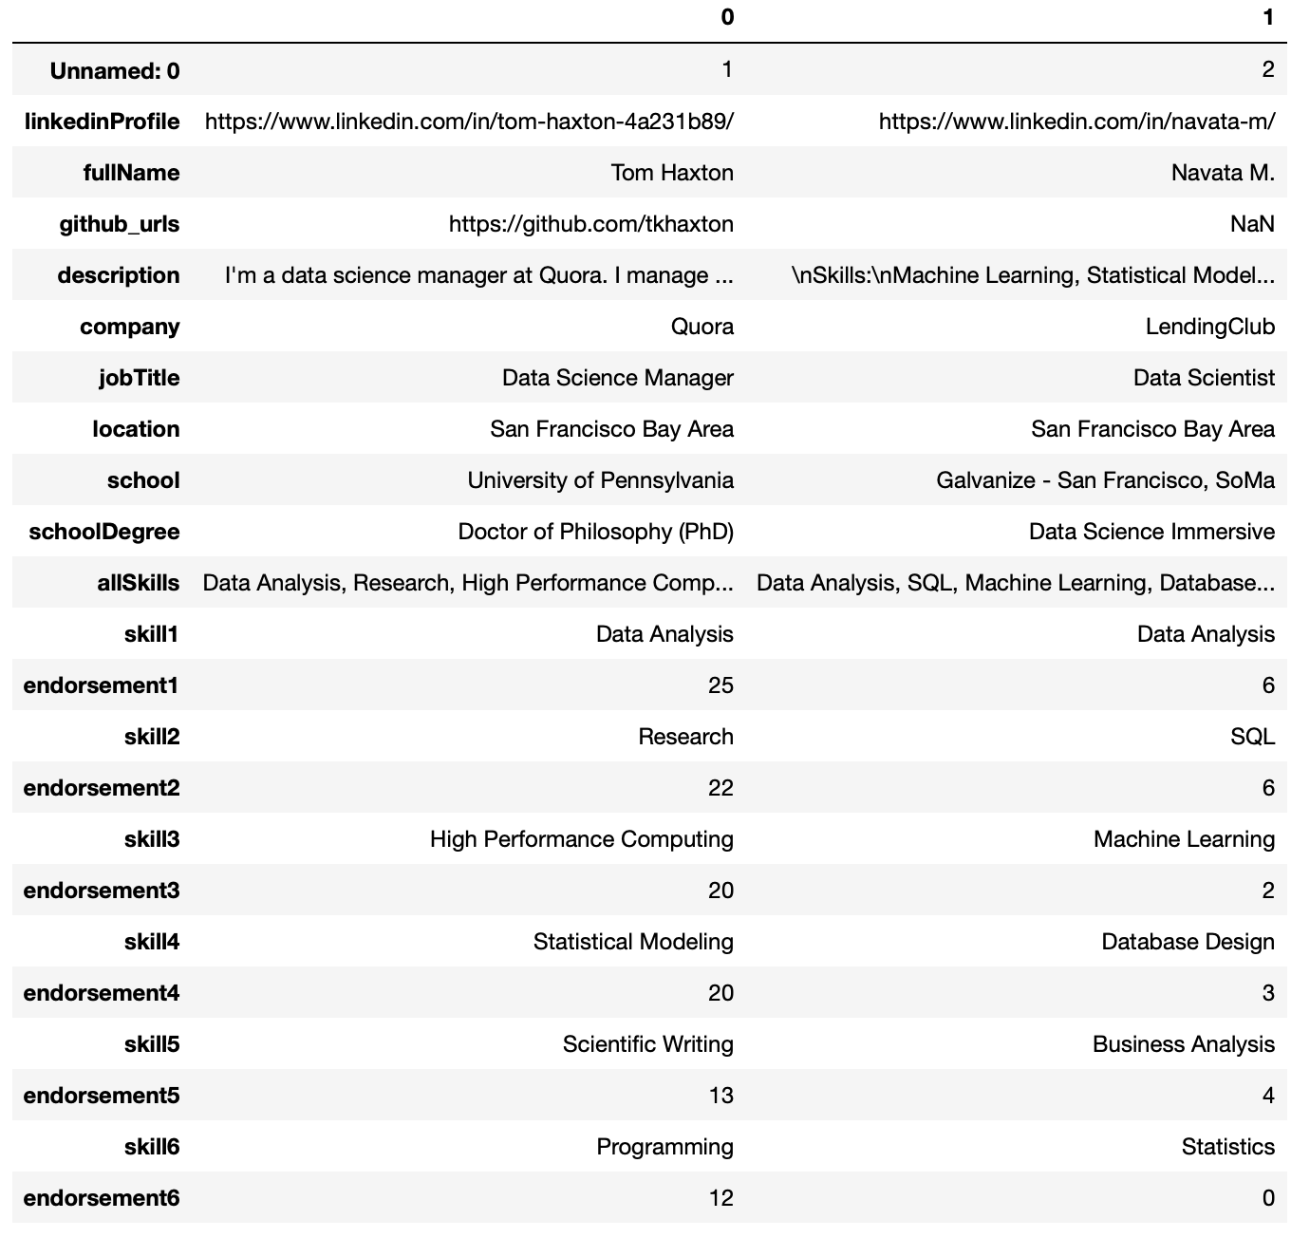
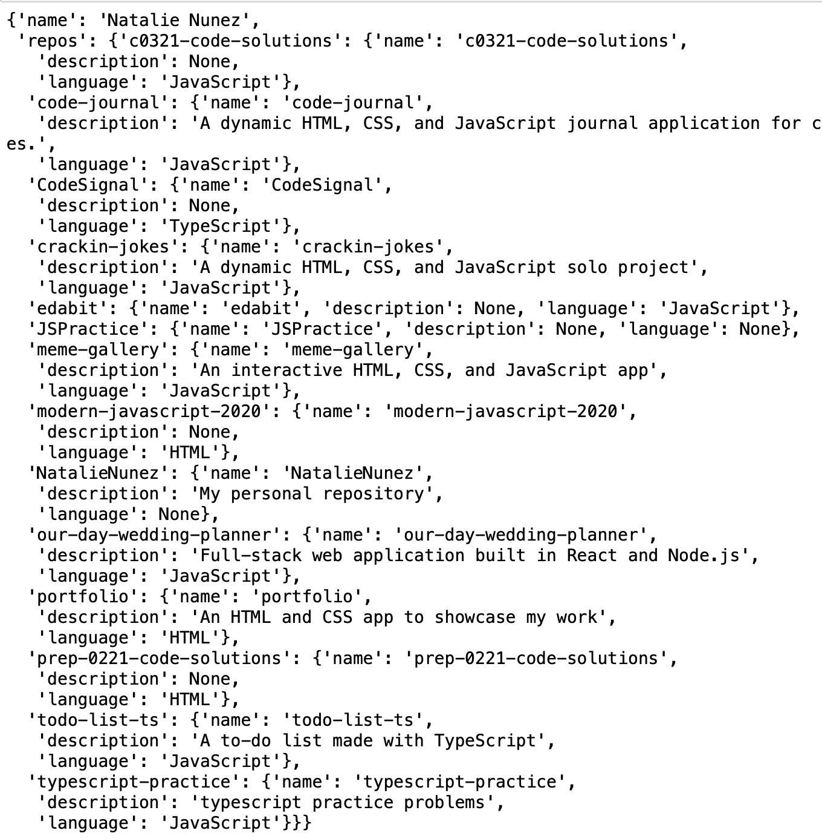
Data Samples
Structured Data(LinkedIn): CSV
Semi-structured Data(Github): JSON

Slide 6
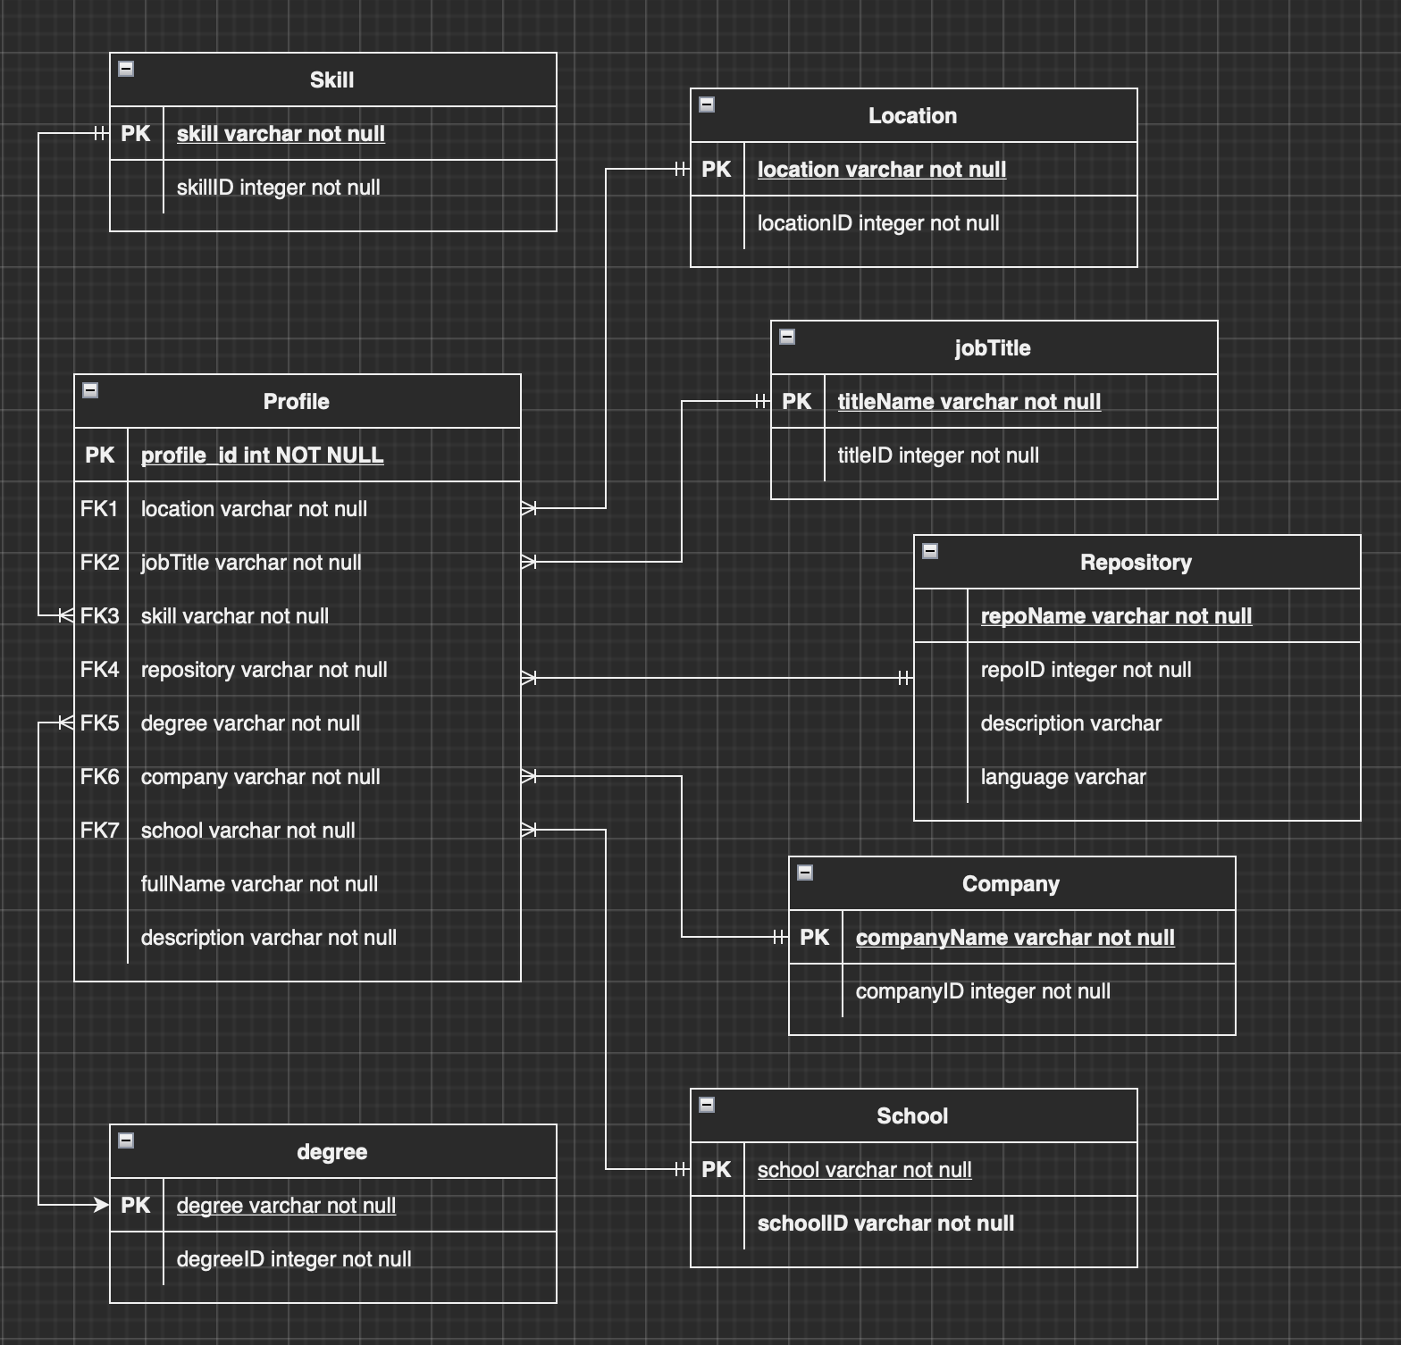
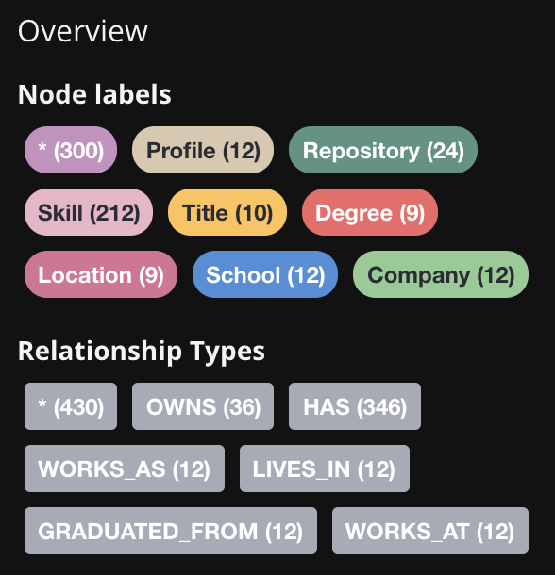
Data Integration

Slide 7
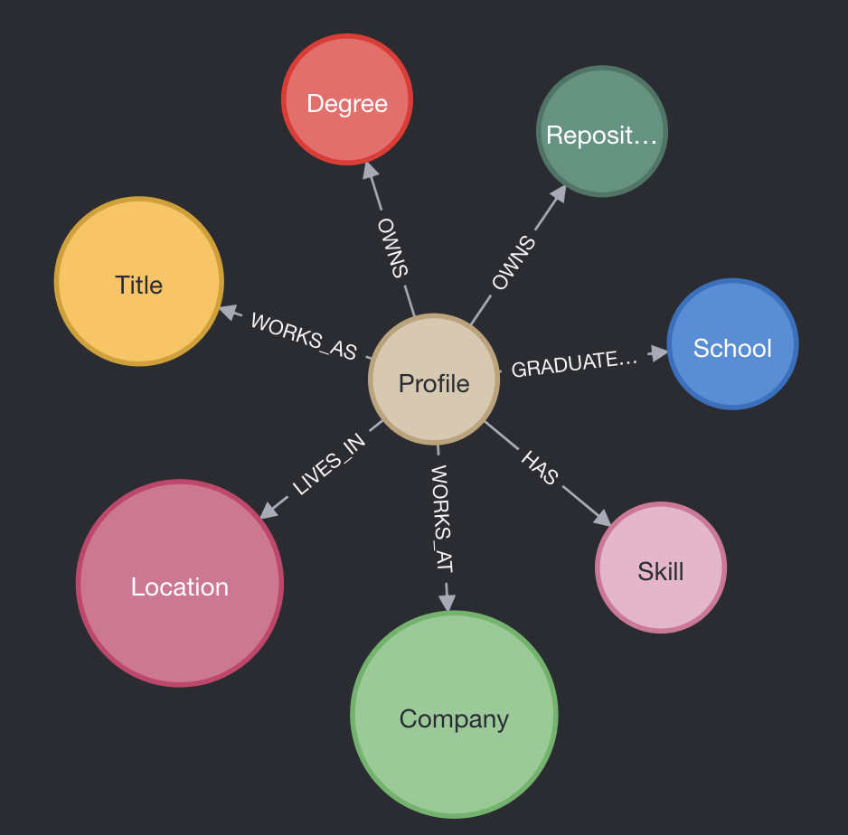
Knowledge Graph Summary
Type | Edges count
HAS | 15916
OWNS | 1221
WORKS_AS | 452
LIVES_IN | 452
GRADUATED_FROM | 452
WORKS_AT | 384
Total 4643 Nodes​
Total 1887 relationship(Edges)

Slide 8
Knowledge Graph – Sample Queries
Look up for a specific professional's profile
Find professionals with specific skill sets from a recruiter's perspective
Examine professionals' skillsets who work at "FAANG"
Most popular languages used in selected profile's repositories.
Candidates' detailed GitHub repositories information

Slide 9
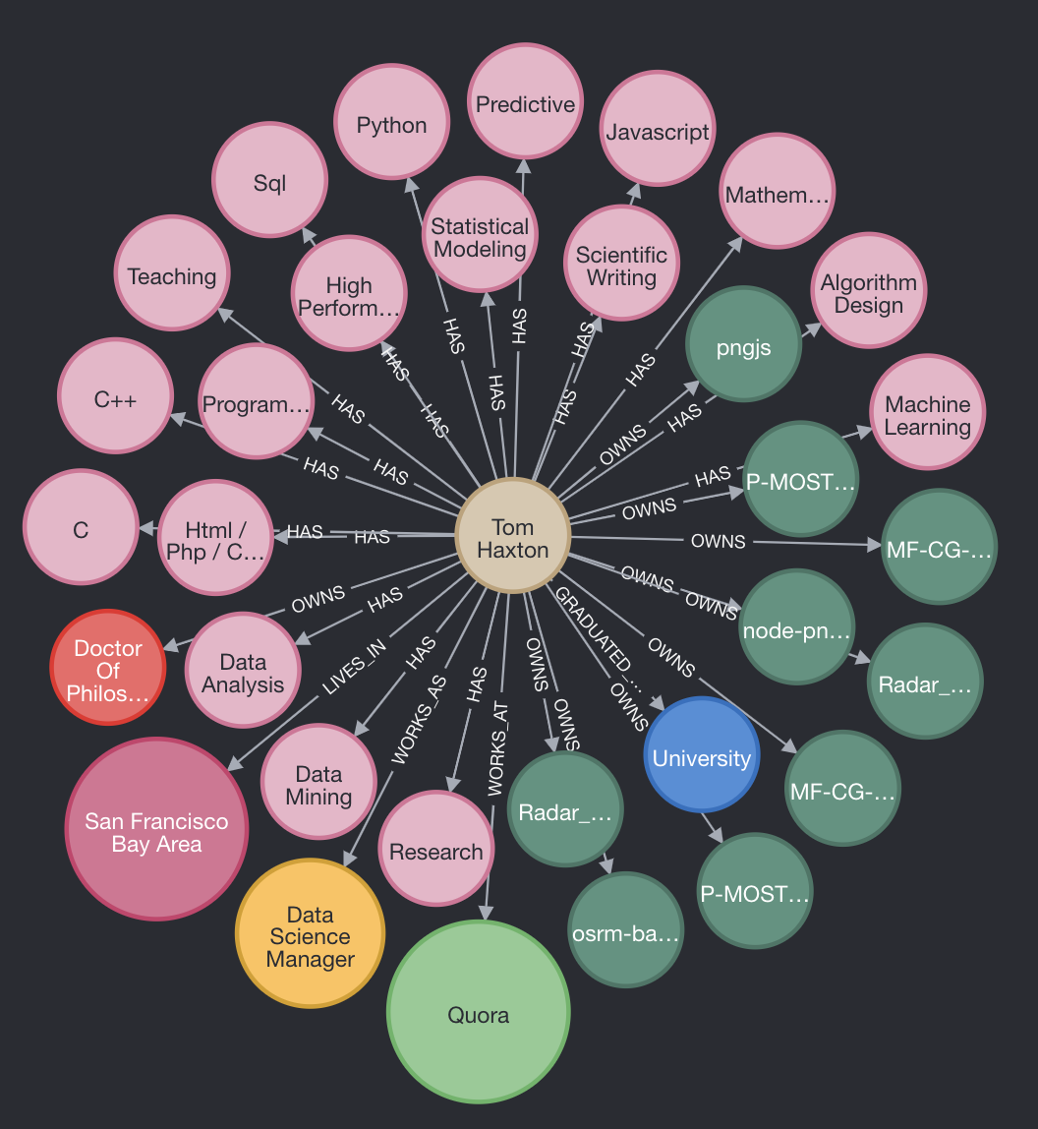
Query and Result
Look up for a specific professional's profile
"Tom Haxton" graduated from "University of Penn" with "PhD" degree works at "Quora" as a "Data Science Manager", he knows "Python", "Sql", "Javascript", etc. and he owns "Project OSRM: C++ backend" written in "C++" and other repositories.

Slide 10
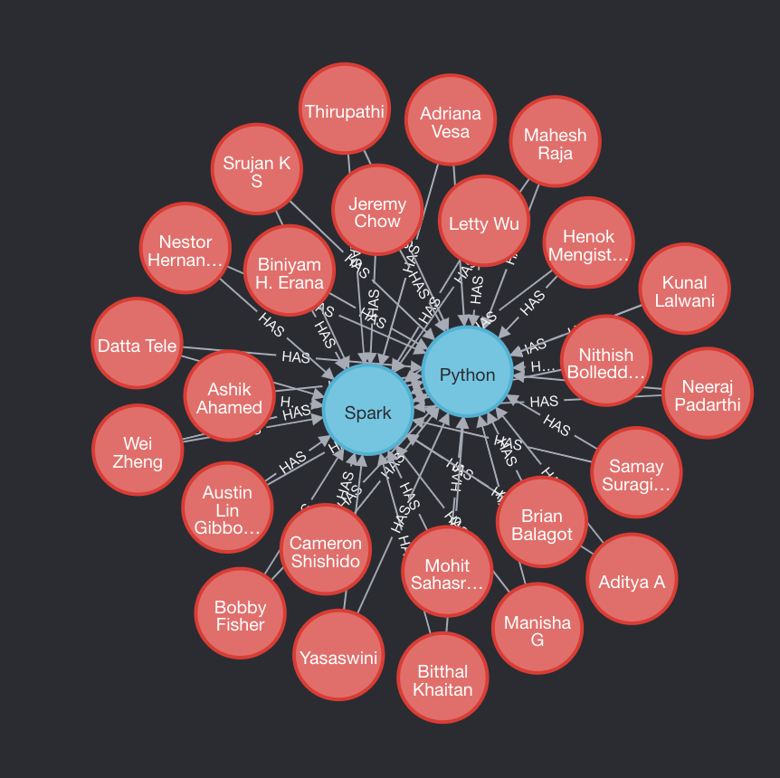
Query and Result
Find professionals with specific skill like "Python" and "Spark" from a recruiter's perspective

Slide 11
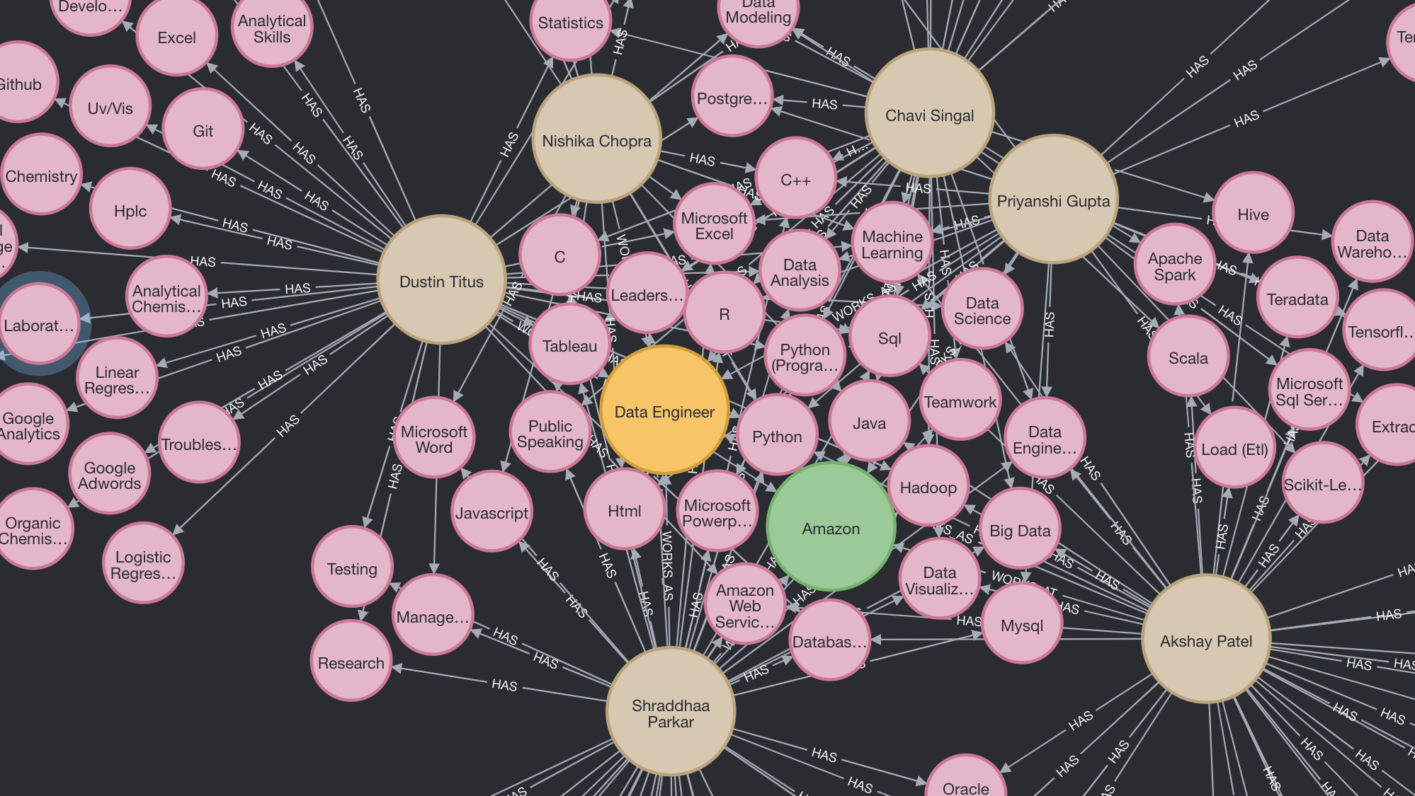
Query and Result
Examine professionals' skillsets who work at "Amazon" as a "Data Engineer".

Slide 12

Neo4j Demo

Slide 13
Challenges and Future work
Challenges
Web scraping issues (CAPTCHAs, search engine results only 20 pages, dwell time, etc. ...)
The speed of acquiring data is capped, 200 linked profiles per day, 1 github profile per script running.
Lack of big picture on graph database integration and visualization
Future work
Utilize multithreading and IP address rotation for web scraping
Automate data flow with ETL tools
Analyze topics and quality of profile's repository using ML methods

Slide 14
Questions?

